Slide 1
SCI in OT
https://manara.edu.sy/

Slide 2
EPIDEMIOLOGY
SCI is relatively rare, afflicting approximately 12,000 people a year in the United States. The number of people with SCI alive today in the United States is estimated to be in the range of 236,000 to 327,000.
The causes of SCI as tracked by NSCISC since 2005 are as follows. Approximately 39.2% of SCIs are caused by motor vehicle accidents, 28.3% by falls, 14.6% by violence (mostly gunshot wounds), and 8.2% by sports injuries. Other causes, such as nontraumatic SCI, account for the remaining 9.7% (NSCISC, 2012). Nontraumatic SCI is caused by spinal stenosis, tumors, ischemia, infection, and congenital diseases (van den Berg et al., 2010).
https://manara.edu.sy/

Slide 3
SCI occurs mostly in adolescents and young adults (ages 15–29 years of age) and in elderly people aged 65 years and older, and the most common causes of traumatic SCI are vehicular accidents and falls, respectively.
Generally, the level of education of injured individuals is somewhat lower and the unemployment rate is somewhat higher than in the general population. At injury, 51.95% of individuals are single, and the likelihood of getting married postinjury is somewhat lower than the general population.
https://manara.edu.sy/

Slide 4
COURSE AFTER SPINAL CORD INJURY
SCI causes a disruption in the motor and sensory pathways at the site of the lesion. Because the nerve roots are segmental, a thorough evaluation of motor and sensory function can identify the level of lesion.
For example, if the spinal cord is completely severed at the level of the 6th cervical nerve root, motor and sensory information below that level no longer can travel to and from the brain. This results in paralysis of muscular activity and absence of sensation below the level of injury.
https://manara.edu.sy/

Slide 5
Immediately after the injury, a period of spinal shock occurs, characterized by areflexia at and below the level of injury. Spinal shock may last hours, days, or weeks. As soon as spinal shock subsides, reflexes below the level of injury return and become hyperactive.
At the level of injury, areflexia may remain as the reflex arc is interrupted.
https://manara.edu.sy/

Slide 6
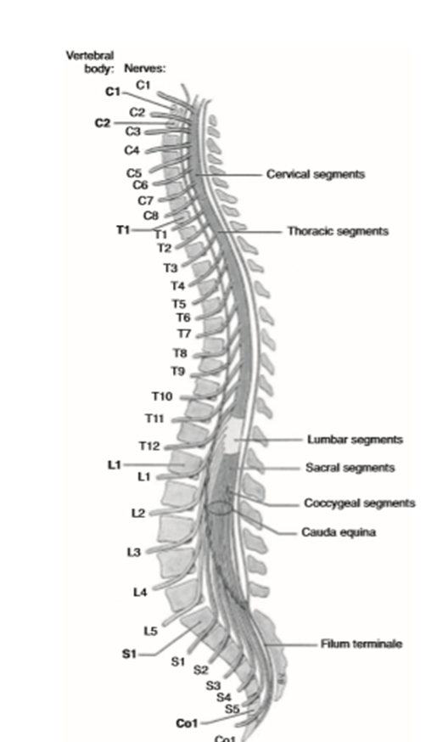
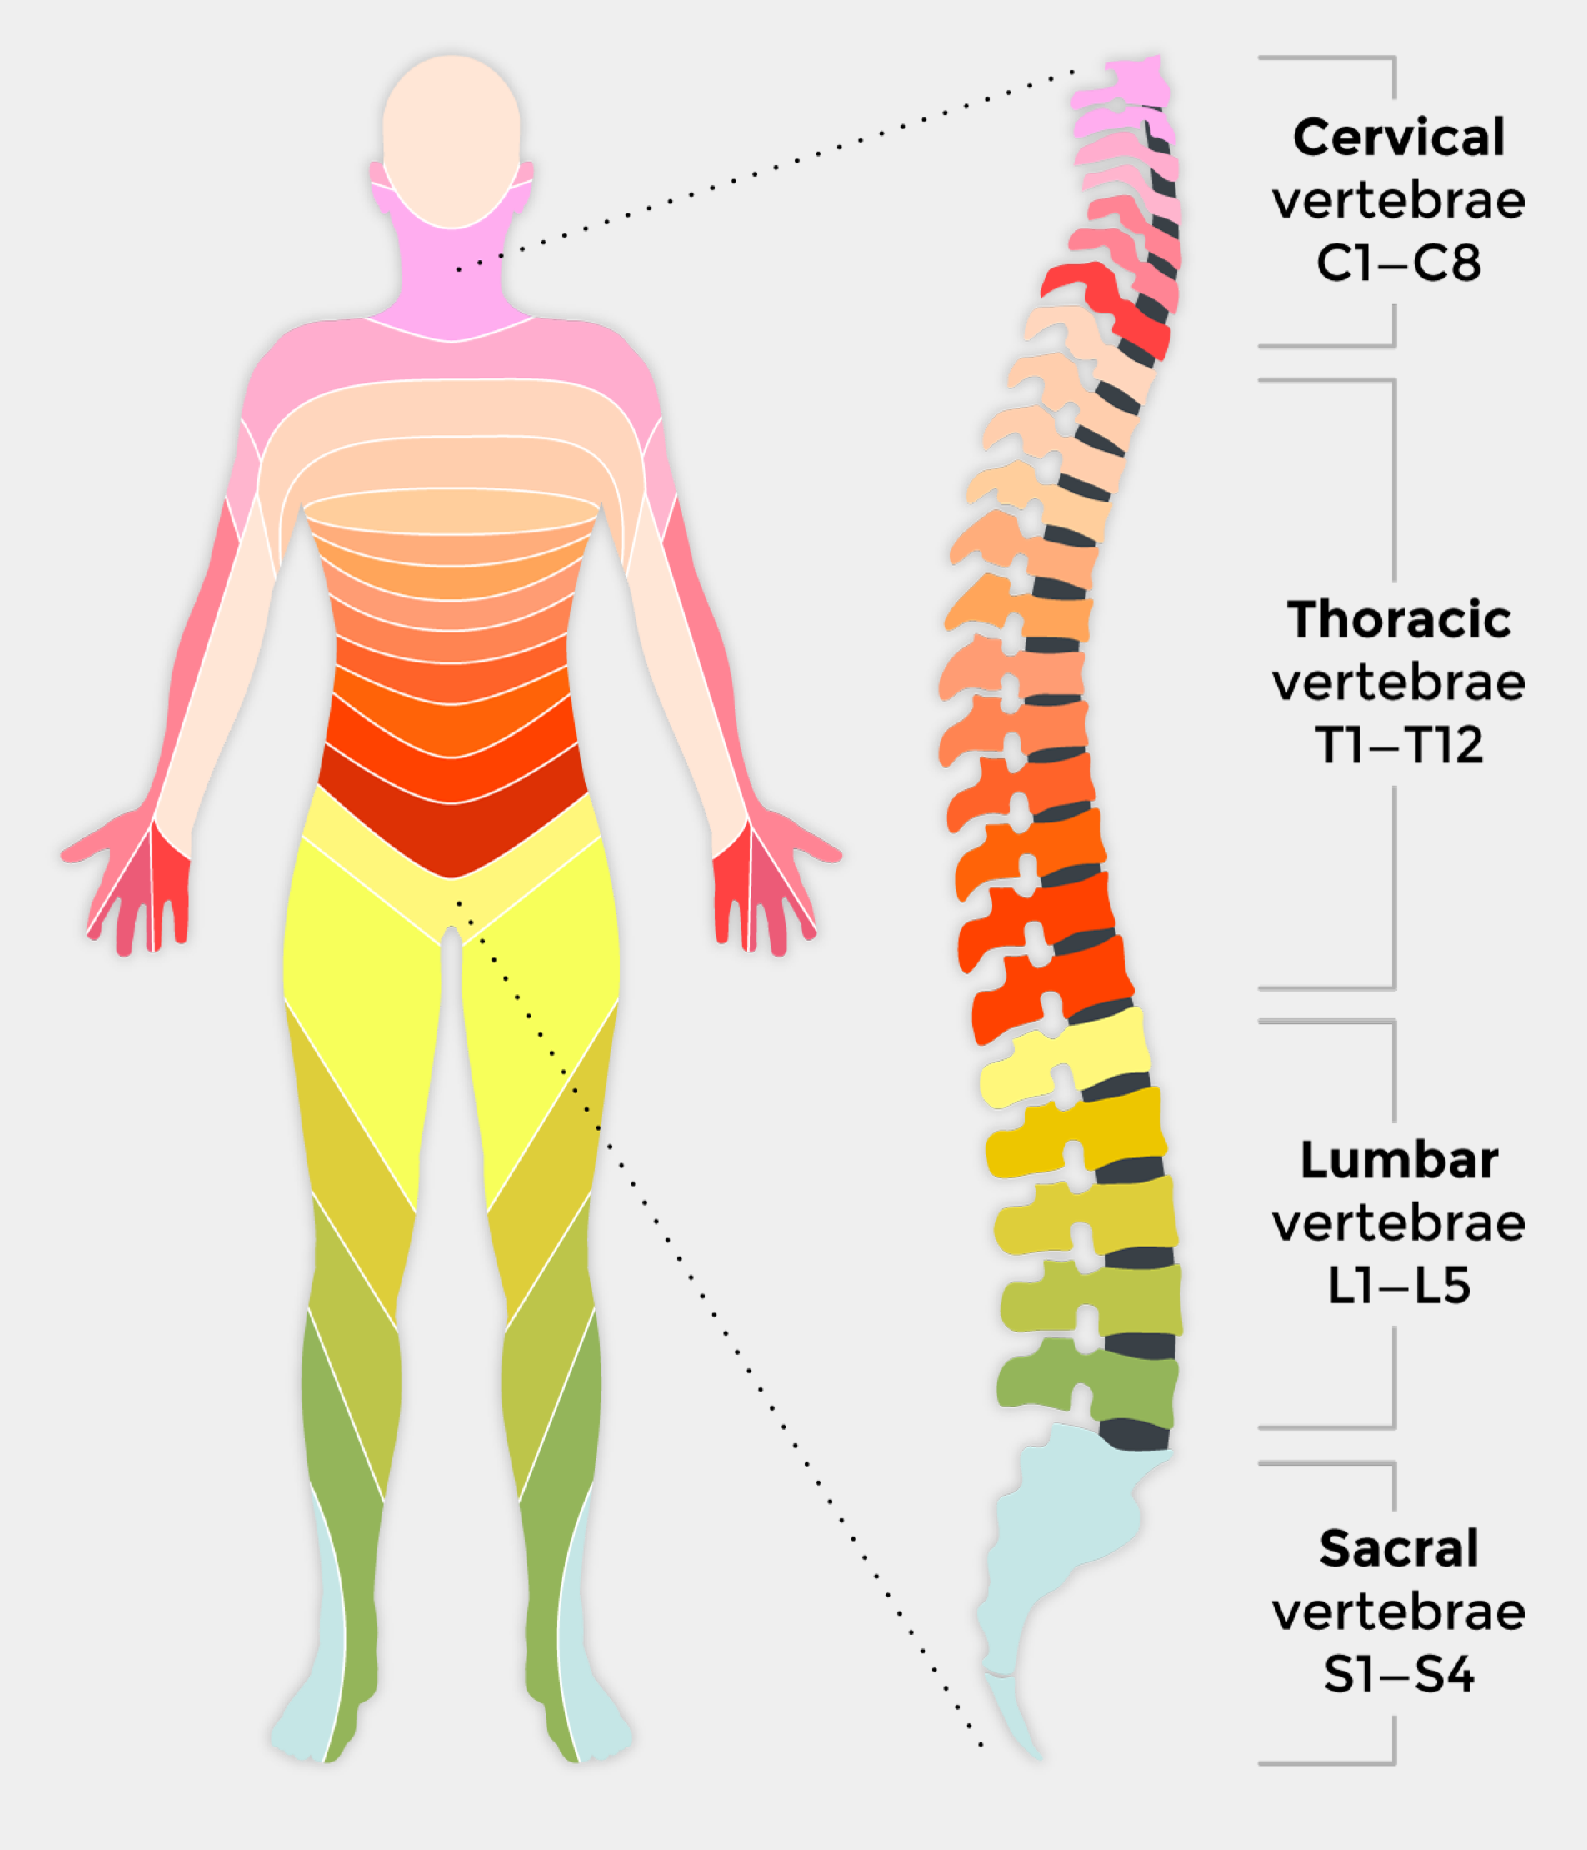
Neurological Classification of Spinal Cord Injury
https://manara.edu.sy/

Slide 7
Tetraplegia results in functional impairment in the arms, trunk, legs, and pelvic organs. The term tetraplegia, which has replaced quadriplegia, is defined as impairment in motor and/or sensory function in the cervical segments of the spinal cord.
Paraplegia refers to motor and sensory impairment at the thoracic, lumbar, or sacral segments of the cord.
The neurological level is diagnosed by the physician according to the motor and sensory level. The motor level is determined by testing 10 key muscles on each side of the body, and the sensory level is determined by testing sensation of 28 key points on each side of the body

Slide 9
The neurological level of injury (NLI) is the lowest segment of the spinal cord at which key muscles grade 3 or above out of 5 on manual muscle testing (MMT), and sensation is intact for this level’s dermatome . Also, the level above must have normal strength and sensation.
For example, a person is diagnosed as having C6 tetraplegia when radial wrist extensors test 3 out of 5 and sensation is intact for the C6 dermatome. Furthermore, all motor and sensory status above the C6 level is intact. Skeletal level refers to the level of greatest vertebral damage (ASIA, 2011).

Slide 10
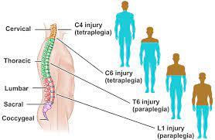
https://manara.edu.sy/

Slide 11
Functional level , a term used by occupational and physical therapists, refers to the lowest segment at which strength of important muscles (key and non-key muscles by ASIA terms) is graded 3 or above out of 5 on MMT and sensation is intact. These muscles significantly change functional outcomes.

Slide 12
Complete injury consists of the absence of sensory and motor function in the lowest sacral segments (S4–S5) (ASIA, 2011). Consider the patient in the Case Example who has a C6 complete injury (also called AIS A). He does not have either sensation or motor have either sensation or motor function in S4-S5 but does have some muscle and sensory function above that level.

Slide 13
The term incomplete injury should be used only when there is partial preservation of sensory and/or motor function below the neurological level and must include the sacral segments (ASIA, 2011). The physician tests innervation at the lowest sacral segment, including anal sensation and sphincter contraction

Slide 14
Central cord syndrome, the most common syndrome, is an incomplete injury, often caused by falls; it results in greater weakness in the upper limbs than in the lower limbs. This injury occurs mostly to older people and is often associated with cervical stenosis (ASIA, 2011).

Slide 15
Brown-Sequard syndrome is an incomplete injury with damage to half of the cord causing ipsilateral proprioceptive and motor loss and contralateral loss of pain and temperature sensation. This syndrome is rarely seen in its pure form (ASIA, 2011).

Slide 16
Anterior cord syndrome is a rare syndrome associated with absent blood supply to the cord causing the loss of motor control, pain, and temperature sensation below the injury. Proprioception and light touch are preserved (ASIA, 2011

Slide 17
Cauda equina syndrome is a lower motor neuron injury to the lumbosacral nerve roots within the spinal canal. It results in areflexic bladder and bowel and paralysis or weakness of the lower limbs (depending on the level of injury) (ASIA, 2011).

Slide 18
Conus medullaris syndrome is similar to cauda equina syndrome but in addition to lesions to the lumbar nerve roots, the cord is also damaged, resulting in a mixed physical picture with some preservation of reflex activity. The bladder, bowel, and lower limbs are affected (ASIA, 2011).

Slide 19
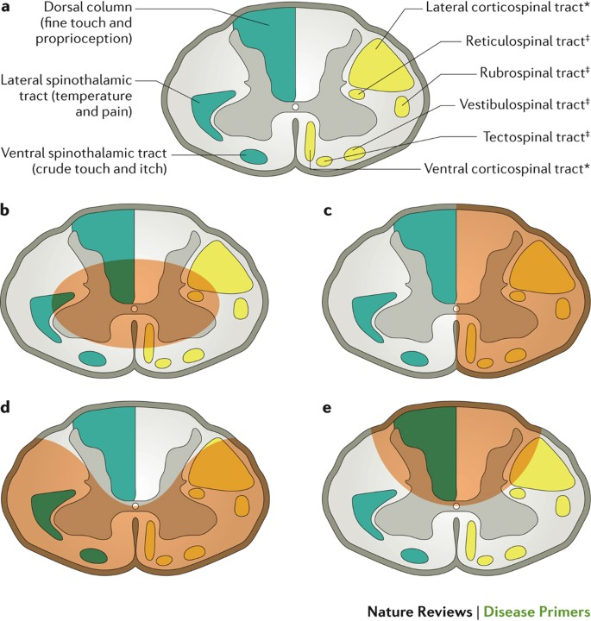
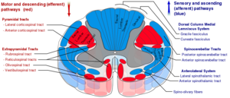
https://manara.edu.sy/

Slide 20
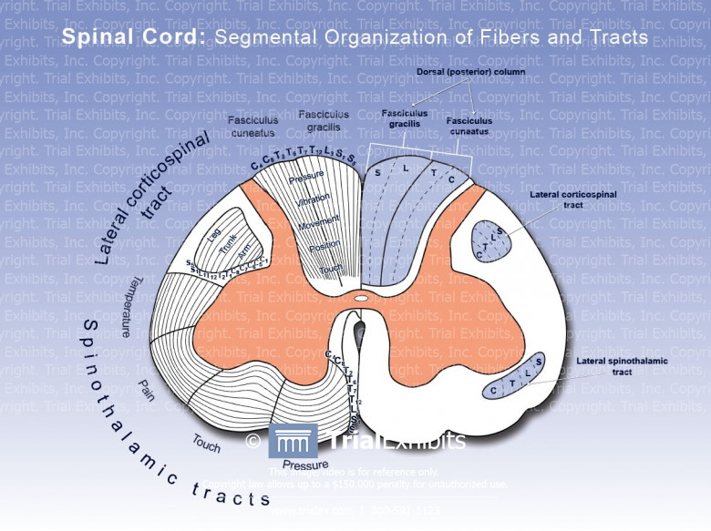
https://manara.edu.sy/

Slide 21
https://manara.edu.sy/

Slide 22
https://manara.edu.sy/

