Slide 1
International Collegiate Programming Contest ICPC

Slide 2
Content
ICPC Overview
Rules of the contest
Problems Overview
Benefits of Participating
How to prepare for ICPC

Slide 3
ICPC Overview
Competitive Programming
Competitive programming (also known as sports programming) is a mind sport usually held over the internet or a local network. Competitive programming is recognized and supported by several multinational software and internet companies, such as Google and Facebook.
A programming competition generally involves the host presenting a set of logical or mathematical problems. Contestants are required to write computer programs capable of solving these problems
the process of solving a problem can be divided into two broad steps: constructing an efficient algorithm and implementing the algorithm in a suitable programming language

Slide 4
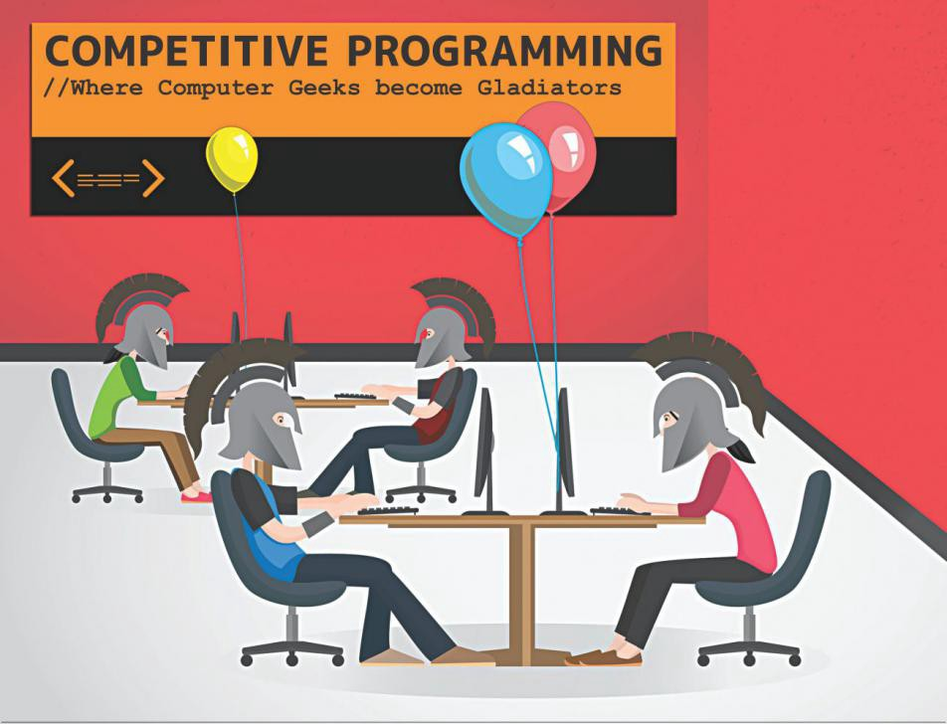
ICPC Overview
The oldest, largest, and most prestigious programming contest.
It is a battle of the brains.

Slide 5
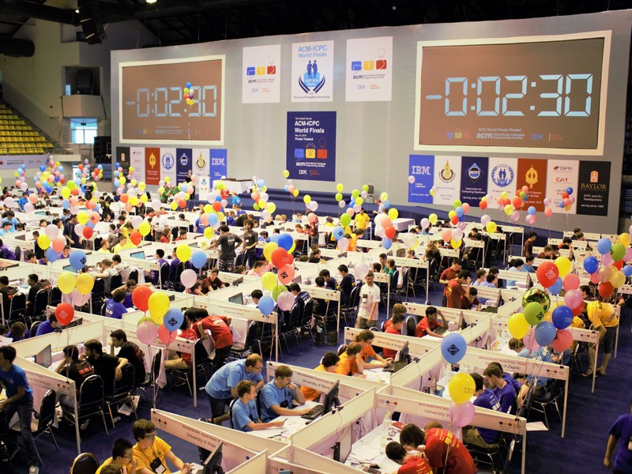

Slide 6
ACM ICPC, ACPC, SCPC

Slide 7
ICPC Levels
Local level – Syrian Private Universities CPC (SPUCPC)
National level – Syrian CPC (SCPC)
Regional level – Africa and Arab CPC (ACPC)
International level – International CPC (ICPC)

Slide 8
Contest Environment & Rules
A Team consists of 1 coach and 3 participants
The problem set consists of [11 – 14] problem
The typical duration of the contest is 5 hours
Each team uses a single workstation
After submitting solutions to the judges, a reply message is received indicating the status
Available programming languages C, C++, Kotlin, python3 or JAVA
It is available to print some of your codes during the contest
It is allowed to bring references, but not phones or USB devices
A trial contest is held a day before the official contest

Slide 9
Contest Environment & Rules
Scoreboard is available, but it is frozen last hour [blind hour]
Teams are ranked based on the number of problems they have solved,
and subsequently, by the time taken to solve them.
Advancing Through Levels
Local → National, between 5 and 15 teams qualify.
National → Regional, between 5 and 15 teams qualify, with a maximum of 3 teams per university
Regional → World Finals, between 5 and 15 teams qualify, with only one team per university allowed to participate

Slide 11
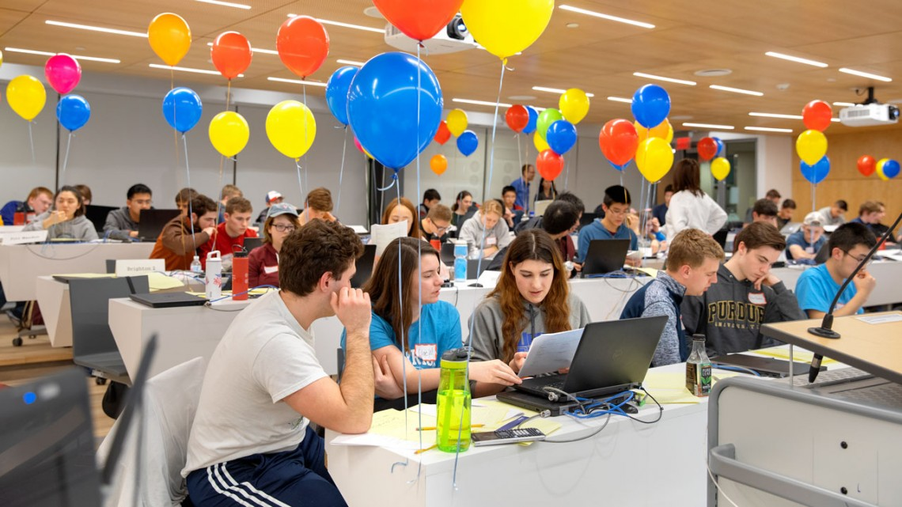
Problems Overview
Parts of a problem
Label & Title
Time & Memory Limits
Statement
Input From & Constraints
Output From
Examples
Notes

Slide 12
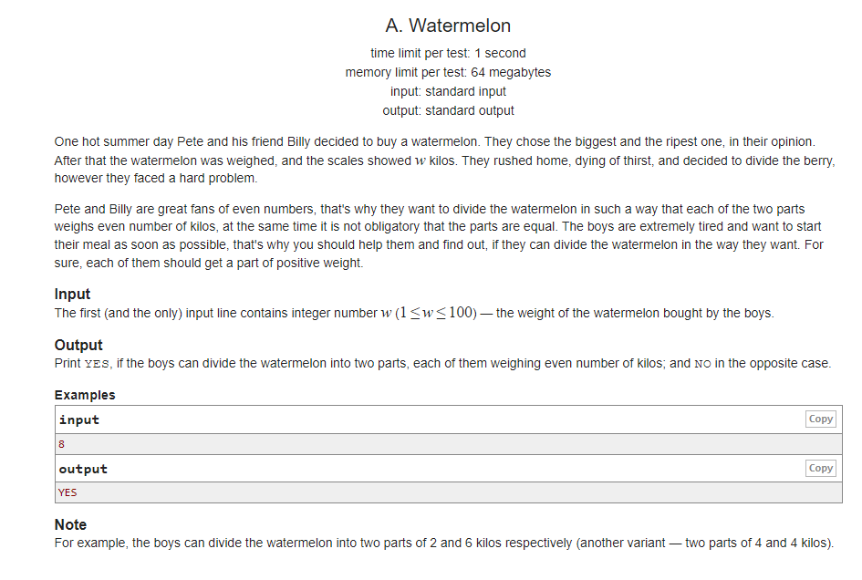

Slide 14
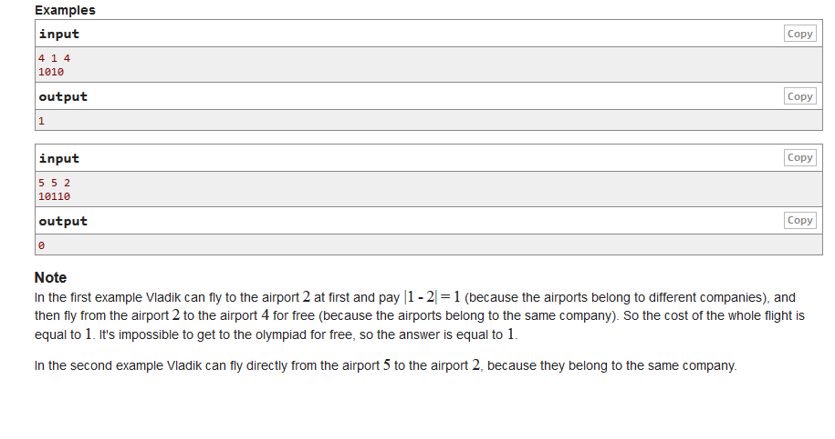

Slide 15
Benefits of Participating
Competitive programming boasts a lively community.
Participating in ICPC competitions can greatly assist in
preparing for technical interviews.
ICPC enhances a range of skills, including coding, algorithmic thinking and analysis, time management, and more.
In addition to improving skills, ICPC can also expand job opportunities.
ICPC can serve as a valuable entry point into the field of software development.

Slide 16
How to Prepare For ACM
Pick a programming language
Solve problems
Learn new algorithms and data structures
Participate in online contests

Slide 17
Thank you
By Homam Khaddour | Najm Al-Diab & Saleh Rabea

