Slide 1

Periodontics
Dr. Lama Hammoud

Slide 2
Anatomy of the Periodontium:
All dentists deal with the periodontal tissues in the course of their treatment, but complicated or complex cases can be referred to a periodontist—a dentist who has completed two to three years of additional education in the treatment of periodontal diseases. Periodontology is of the ADA-recognized specialties and is the field of dentistry that deals with the treatment of diseases of the tissues around the teeth, commonly called the periodontium. The periodontium serves as an attachment apparatus and is composed of four major tissues

Slide 3
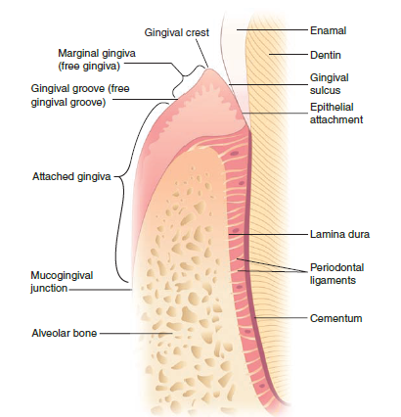

Slide 4
A. gingival: fibrous, epithelial tissue surrounding a tooth; may be divided into three types:
attached: the portion that is firm, dense, stippled, and bound to the underlying periosteum, tooth, and bone. The keratinized (=hard or horny) tissue, also called masticatory mucosa, where the gingiva and mucous membrane unite, is indicated by the color changes from pink gingiva to red mucosa, and is called the mucogingival junction.
marginal: the portion that is unattached to underlying tissues and helps to form the sides of the gingival crevice; also called the free margin gingiva and forms the gingival sulcus (= groove), approximately 1 to 3 mm in depth.
papillary: the part of the marginal gingiva that occupies the interproximal spaces. Normally this tissue is triangular and fills the tooth embrasure area, and also is called the interdental papilla

Slide 5
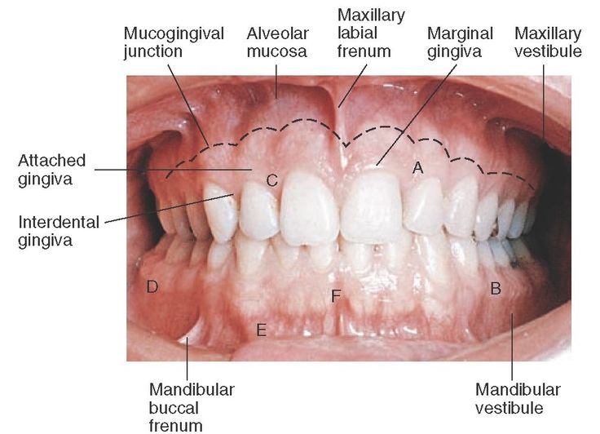

Slide 6
B. periodontal ligaments: bundles of fibers that support and retain the tooth in the alveolar socket. The five principal types of periodontal membrane fibers are:
alveolar crest fibers: located at the cementoenamel junction; assists with the retention of the tooth in its socket and protects the deeper fibers.
horizontal fibers: attached along the upper side of the root; assists in the control of lateral movement.
oblique fibers: connects the majority of the root in the alveolar socket; assists with the tooth’s resistance to axial forces.
apical fibers: arranged in bundles and attaches the apex of the tooth to the alveolar bone; assists with prevention of tipping and dislocation, and also protects the nerve and blood supply to the tooth.
interradicular fibers: also arranged in bundles and located in the furcations of multiple rooted teeth; assists the tipping, turning, and dislocation of the tooth.

Slide 7
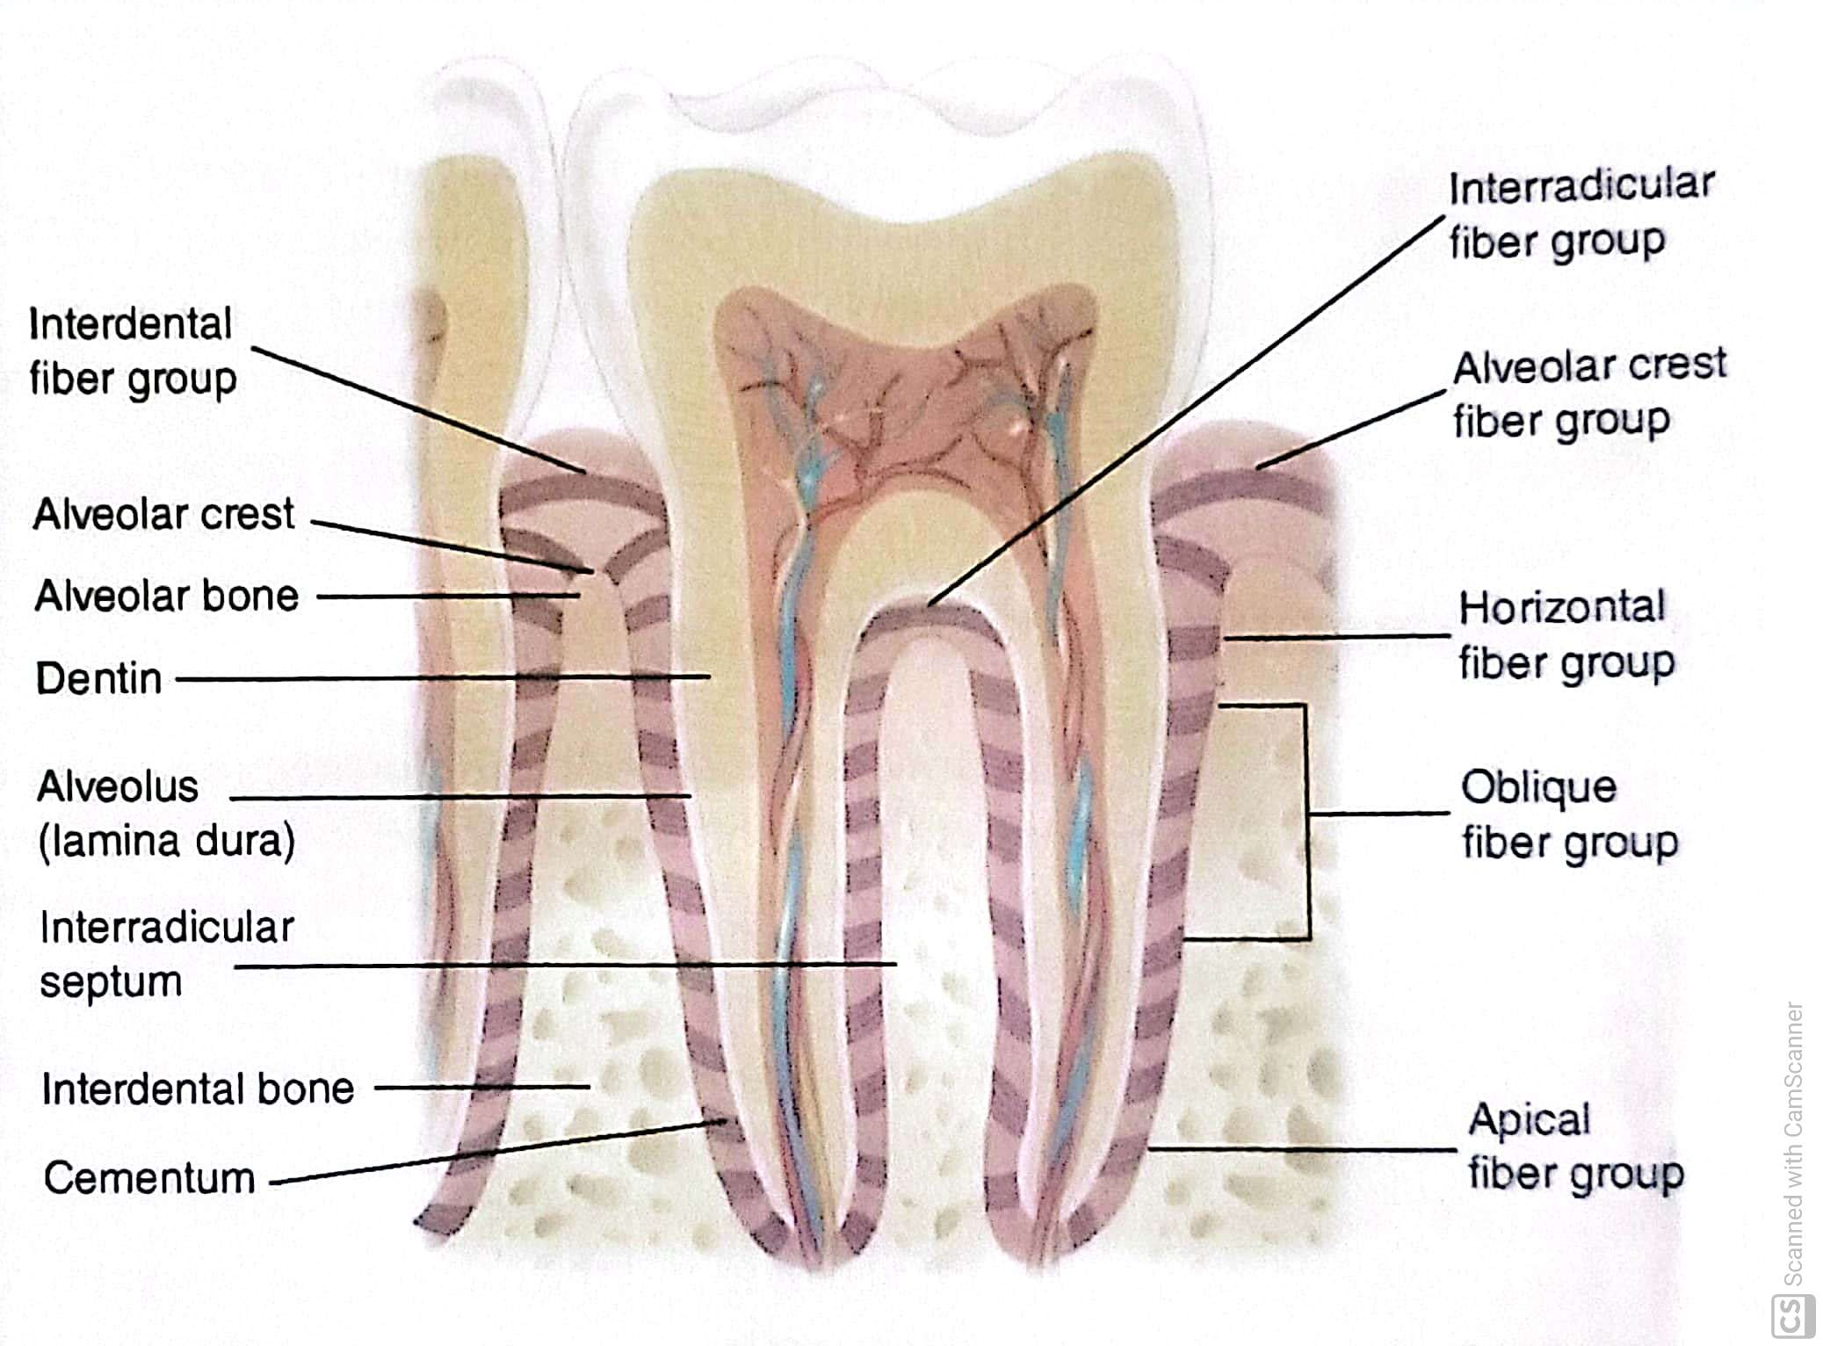

Slide 8
C. cementum: outer hard, rough surface covering of the root section of the tooth that permits the fiber attachment for tooth retention.
D. alveolar bone process: compact bone that forms the tooth socket; supported by stronger bone tissue of the mandible and maxilla and accepts periodontal fiber attachment. The alveolar process makes up the cribriform (sieve-like) plate to form and line the tooth socket. This outline is called lamina dura (= lining, thin layer) and is easily viewed on radiographs.

Slide 9
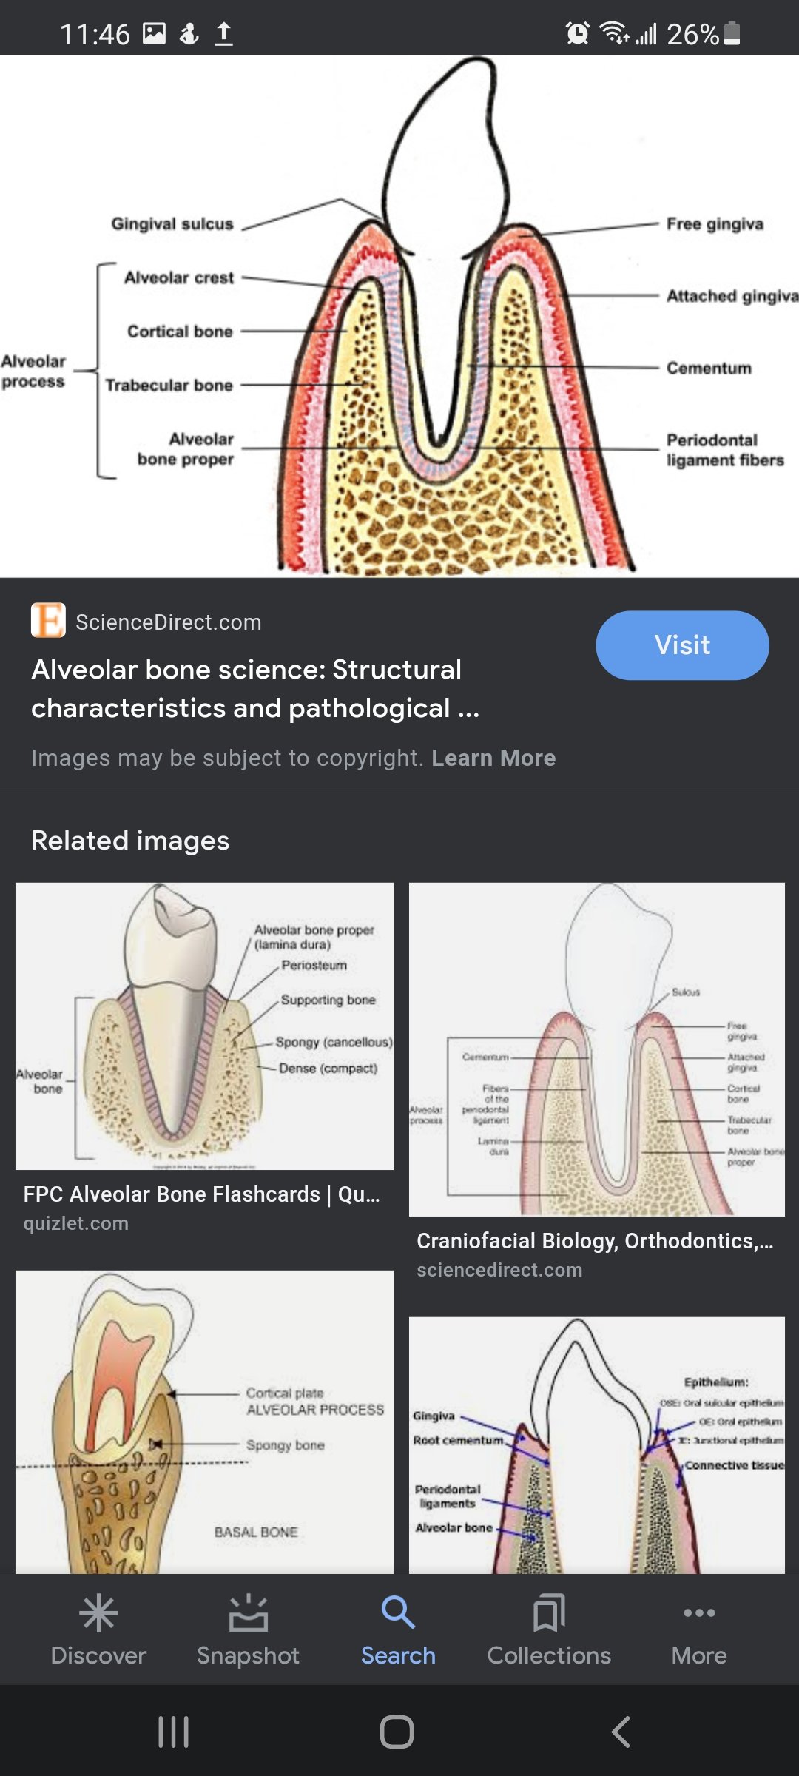

Slide 10
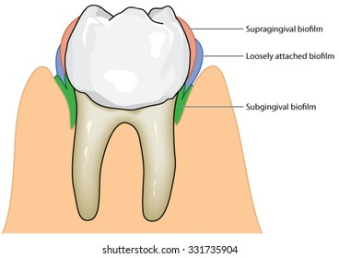
Etiology and Symptoms of Periodontal Diseases:
In the etiology of problems affecting the periodontium, the major contributing factors are plaque (plate or buildup) and calculus Teeth acquire an adhering biofilm or pellicle , which harbors an assortment of bacterial pathogens and enables plaque to build up. With the addition of calcium and phosphorus salts found in saliva and mouth fluids, a hard substance called calculus (also know as tartar) forms.

Slide 11
These gingival irritants are classified as either supragingival (found on the tooth crowns) or subgingival (found on root surfaces below the gingival margin).
When this collection of calculus and plaque with pathogens extends into periodontal pockets, it causes irritation and disease. Many health organizations are finding a correlation between periodontal health and major body diseases, such as stroke and circulatory illnesses. Tobacco use and genetic make up play a part in the chances of periodontal disease.

Slide 12
Indications of periodontal disease are:
erythema: The gingiva is red and appears inflamed.
edema: The tissue is overgrown from hyperplasia (excessive number of tissue cells) and hypertrophy (excessive cellular growth). The gingiva looks swollen and irritated. Hyperplastic gum tissue may be caused by drug reactions, allergies, and hormonal changes, as well as response to local irritants and disease.
loss of stippling (spotting): Tone or tissue attachment loosens, and puffy gums become smooth and shiny.
pocket formation: Gingiva is unattached, recession occurs, and the root may be observed.
alveolar bone loss with exudate (passing out of pus): A foul odor is present as supporting bone resorbs; retention is lessening.
mobility: The tooth seems loose and moves under pressure because of loss of attachment. The tooth eventually is lost from lack of support or from extraction.

Slide 13
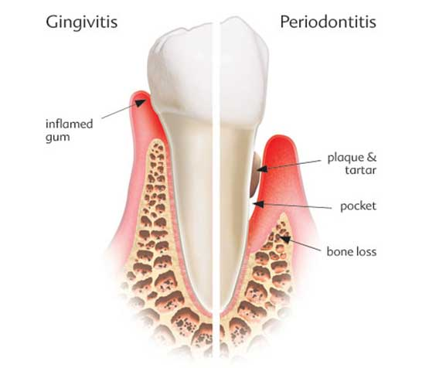
Classification of Periodontal Diseases:
Periodontal diseases can be divided into two main divisions:
  Gingivitis, an inflammation of gingival tissue with no supporting tissue loss
  Periodontitis, inflammation of gingival tissue with involvement of other tissues of the periodontium
Destruction of these tissues varies in degree, intensity, and overall action. To identify each stage and type of periodontal involvement, the American Academy of Periodotology (AAP) devised the following classification system for periodontal diseases:

Slide 14
A. Gingival disease:
Dental plaque involvement: (most common) Tissues react to irritants.
Dental plaque with systemic factors included: Pregnancy, hormone, medication, or malnutrition may modify and intensify the disease course of action; sometimes called induced gingivitis.
Nondental plaque tensions: These are of specific bacterial, viral, fungal, or genetic origin, such as gonorrhea, herpes, HIV, and candida infections.
Allergies: The patient may be allergic to dental-restorative materials and have reactions to food, additives, and so forth.
Traumatic lesions, injury: The patient my have been subjected to an external force or have been injured in some way.

Slide 15
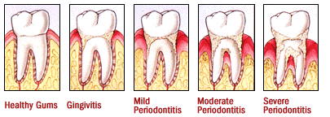
B. Periodontal disease:
Chronic periodontitis: Previously termed adult periodontitis, this is the most common type of slowly progressive periodontal disease. May be subdivided according to extent and severity into localized with <30% involvement and generalized with >30% involvement. Severity is measured based on the amount of clinical attachment loss (CAL) as slight, moderate, or severe.

Slide 16
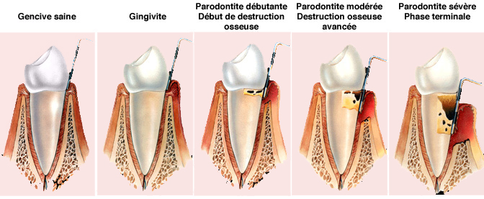

Slide 17
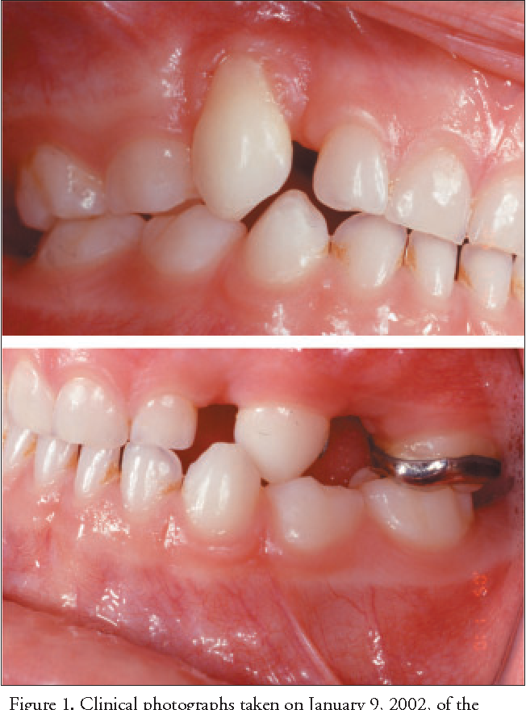
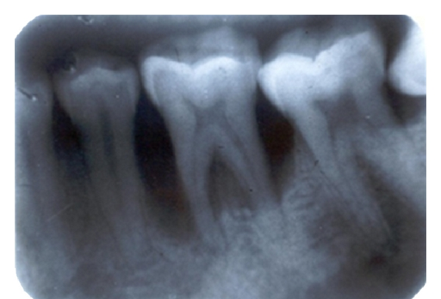
Aggressive periodontitis: Previously termed early-onset periodontitis, this is a rapidly progressive disease. Subclassifications are:
Localized aggressive periodontitis, formerly termed localized juvenile periodontitis (LPJ) affecting young adults
Generalized aggressive periodontitis, formerly termed rapid-progressing periodontitis (RPP)

Slide 18
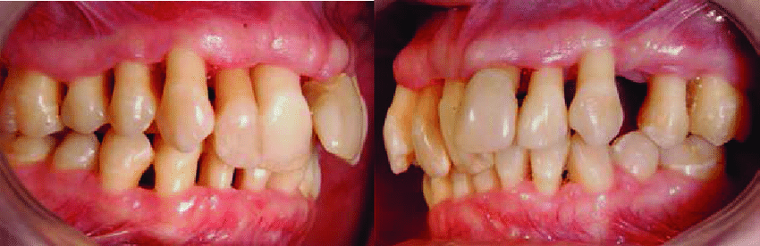
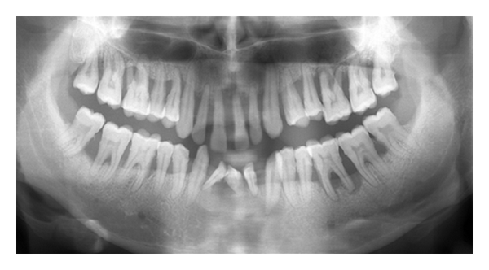

Slide 19
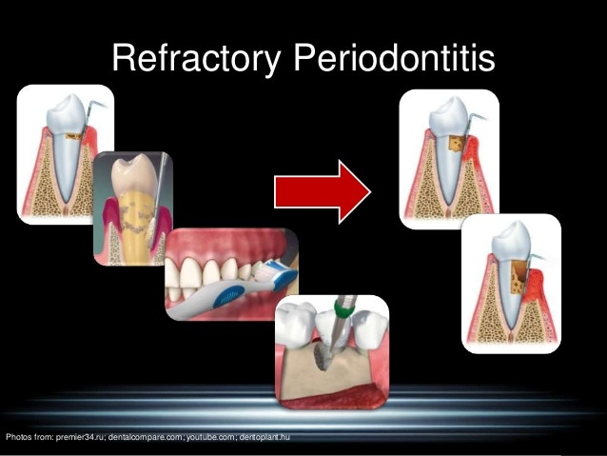
Refractory periodontitis: The periodontitis progresses in spite of excellent patient compliance and provision of periodontal therapy; may be applied to all types of periodontitis. Tissues that are painful, red, and sloughing are said to be desquamative (= shedding, or scaling off ).
Periodontitis as manifested of systemic disease: Periodontal inflammatory reactions occur as a result of diseases and genetic disorders, such as leukemia, HIV, malnutrition, and hormones.

Slide 20
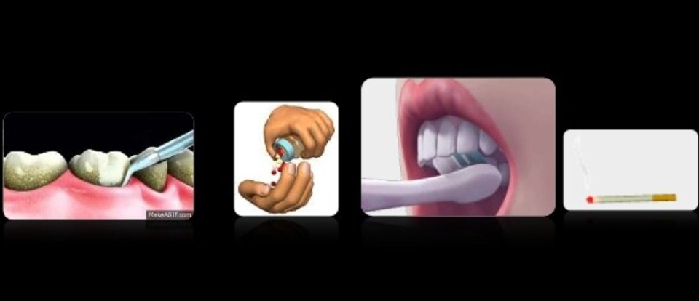

Slide 21
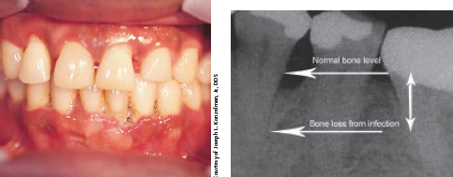
Necrotizing periodontal diseases: Rapid gingival tissue destruction with bacterial invasion of connective tissue may be a manifestation of systemic disease, such as HIV infection. This category is subdivided into two divisions:
  Necrotizing ulcerative gingivitis (NUG): With foul odor and a loss of interdental papilla, sometimes called “trench mouth
  Necrotizing ulcerative periodontitis (NUP): With bone pain and rapid bone loss

Slide 22
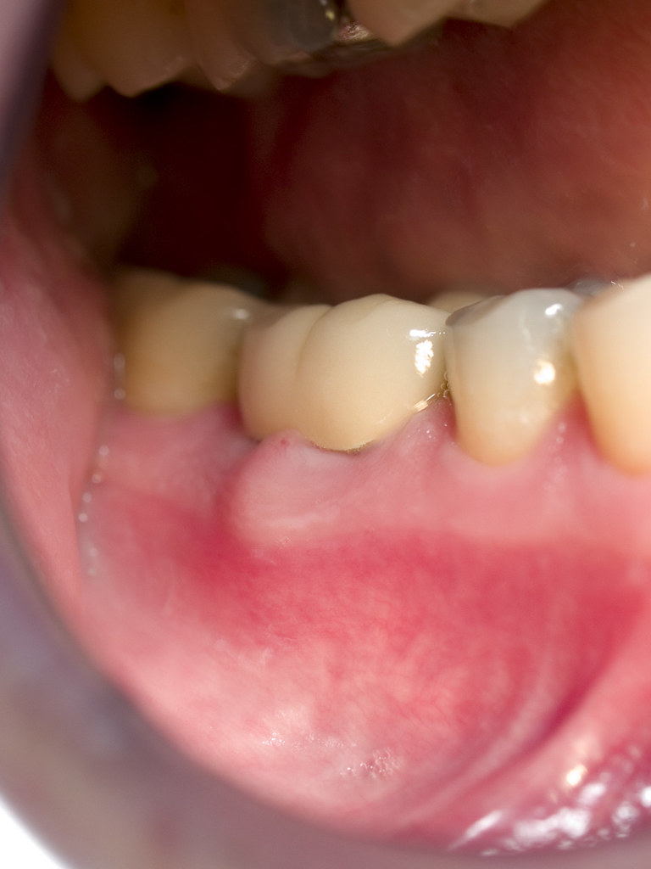
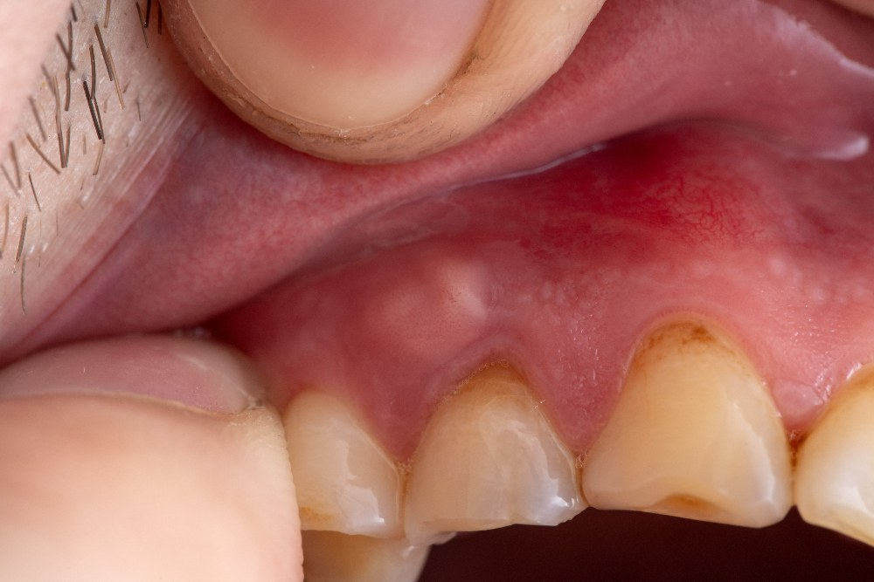
C. Abscesses of the periodontium: Abscesses are classified according to location, such as gingival, periodontal, and pericoronal.

Slide 23
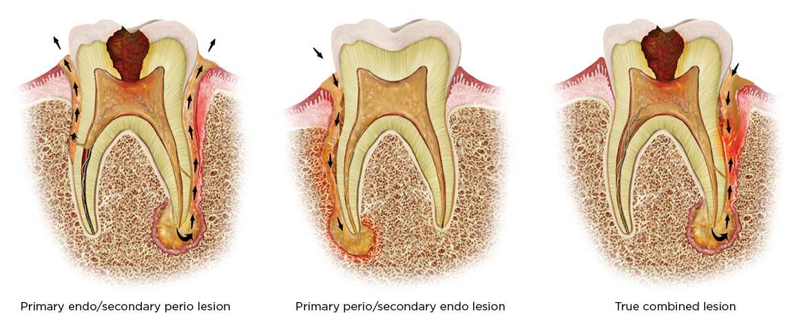
D. Periodontitis associated with endodontic lesions: This simple classification was added to distinguish between periodontitis and periodontitis with endodontic inflammation involvement.
E. Developmental or acquired deformities and condition: Deformities appear around teeth, edentulous ridges, and from trauma

Slide 24
Periodontal Examination and Evaluation:
The patient must receive a thorough exam and evaluation before treatment can be established. This procedure involves:
medical history: questions regarding diabetes, pregnancy, smoking, hypertension, dedication, substance abuse, and so forth.
dental history: chief complaint, past dental records and radiographs, complete assessment of restoration condition, tooth position, mobility.
extraoral structure assessment: exam of oral mucosa, muscles of mastication, lips, floor of mouth, tongue, palate, salivary glands, and the oropharynx area.
periodontal probing depth: charting and recording findings of probe depths, assessing plaque and calculus presence, soft tissue, and implant conditions.
assessing intraoral findings: exam for tori palatinus or tori mandibularis growths and abnormal frenum placement and size.

Slide 25
Measurement and Recording of Periodontal Conditions:
The periodontal examination involves charting and recording tooth conditions and the status of the oral mucosa, particularly the periodontium. Prior to the perio exam, the teeth receive a prophylaxis (scaling, root planing, and polishing of teeth). The professional cleaning of teeth involves the scaling or scraping off of calculus. This is usually accomplished by hand instruments and ultrasonic scaling tips that vibrate and remove the hard deposits from above the gingival crest (supragingival) and below the gingival crest (subgingival). Deposits in the periodontal pockets around the root area are planed by curettage or ultrasonic tips. The combination of the two processes is termed scaling and root planing (SRP) and is followed with a polishing by a slow handpiece with rubber cups or air polishers that spray a force of abrasive powder to cleanse the surfaces. Completion of this process leads to the periodontal survey.

Slide 26
Clinical examination requires obtaining and recording an index (measurement of conditions to a standard ), which rates the status of a particular subject and provides a method to measure the progress of the tested item, such as bleeding or plaque.
To be effective, the index procedure must be followed for each patient, and the same method must be used from one dental source to another. Differentindices apply to different conditions. The common indexes used in periodontics cover plaque, oral hygiene, calculus, debris, periodontal pocket depth, bleeding, grade mobility, root furcation, gingival margin, periodontal disease, and suppurative (pus) involvement, among others. Each practice will choose those measurements, which are considered most indicative, such as calculus, bleeding, and tissue attachment. To obtain measurements for indices, the dentist or hygienist will use a periodontal probe to insert into the gingival sulcus and record the findings.

Slide 27
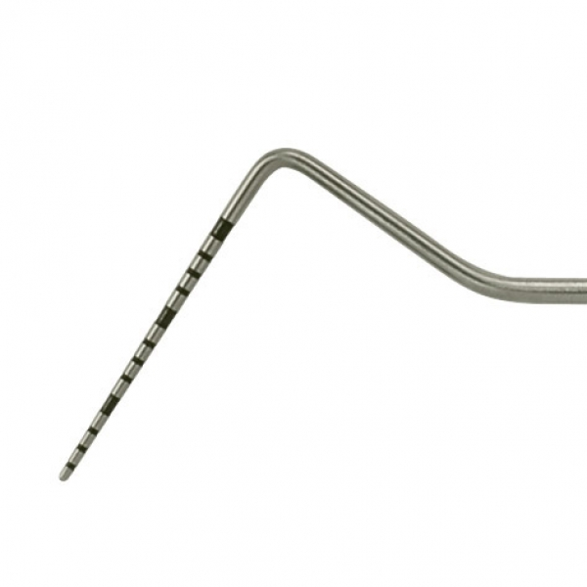
The Periodontal Probe:
The most common instrument used in measuring is the periodontal probe, a round- or flat-bladed hand instrument marked in millimeter increments. The probe tip is inserted into six specific areas with the deepest pocket marking measurement recorded for that spot. The six areas are facial (F), mesiofacial (MF), distofacial (DF), lingual (L), mesiolingual (ML), and distolingual (DL).

Slide 28
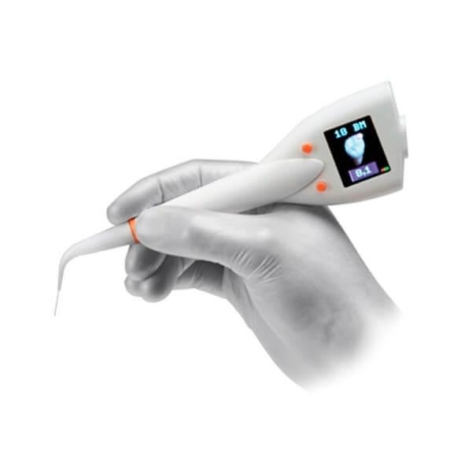
Also available for measurement is an electronic probe such as the DiagnoPen with a perio probe that indicates the pocket condition after the teeth have been scaled and planed
  <5 indicates clean gingival pockets.
  4–40 indicates little calculus or residual calculus left.
  >40 indicates calculus in gingival pockets.

Slide 29
Periodontal Treatment Methods:
Treatments for periodontal conditions vary with the severity of the disease. Treatment may be of a nonsurgical nature, conducted in the dental office with a program of home care, or it may involve extensive surgical care.

Slide 30
Nonsurgical Treatment of the Periodontium:
The nonsurgical treatment of periodontal irregularities and diseases involves a variety of procedures and therapies.
prophylaxis debridement: removing supragingival and subgingival plaque, calculus, stain, and irritants through tooth-crown and root-surface scaling and root planing (SRP). This treatment usually involves ultrasonic tip scaling and hand instrumentation.
tooth and surface polishing: polishing surfaces to remove accumulated extrinsic (outer) stains on the tooth surface and endotoxins (= absorbed pathogens) on the accessible surfaces. This treatment can be completed using air polishers, abrasive cleansing, and handpiece application of nonabrasive rubber cups and points with polishing paste or powder .
selective polishing: term applied to the polishing of chosen tooth sites or areas.
prophylaxis: term applied to the combination of debridement and tooth polishing; used for purposes of insurance and scheduling. Tooth aids, such as flossing and bridge cleaners, perio brushes, and the like are applied and used in necessary attention areas to complete a thorough cleansing.

Slide 31
patient education: customized instruction in oral hygiene; the care of teeth and gingival tissue.
antimicrobial (against small life) therapy: includes prescription mouthwashes (chlorhexidine digulconate); over-the-counter mouthwashes; systemic antibiotics such as tetracycline, penicillin, clindamycin, erythromycin, and metronidazole medicines; and local delivery systems to the site using a gel pack, syringe insertion, or gelatin chip containing antimicrobal products. A new method called Perio Protect offers an antimicrobial medicated application in a custom-made patient tray for patient application.
occlusal adjustment: selective grinding of occlusal cusps to eliminate premature contact.
tooth stabilization: splinting, wire ligation, or bonding of teeth to lessen tooth mobility.
occlusal guards: custom-formed acrylic nightguard to protect from tooth
grinding.

Slide 32
Periodontal Surgery Techniques:
Various specialized surgical treatments are applied in cases of extensive disease of the periodontium. Surgery may involve periodontal knives, instruments, and scalpels. Lately, laser incision with controlled power levels and selected wavelengths to lessen bleeding, swelling, and discomfort is becoming more popular

Slide 33
Some procedures are:
mucogingival excision: used to correct defects in shape, position, or amount of gingiva around the tooth; eliminates the pocket formation and pericoronitis typically found on erupting third molars.
gingivectomy: excision of pocket tissue areas. One end of a pocket marker is inserted the entire depth of pocket and squeezed until the opposite pointed tip penetrates the gingiva, thereby marking a setting for a surgical template pattern. Necrotic tissue is excised and removed.
gingivoplasty: instrumental or laser surgical contour of gingival tissue to remove excessive tissue or pellical edges.
periodontal flap surgery: a loosened section of tissue is separated from the adjacent tissues to enable elimination of deposits and contouring of alveolar bone.

Slide 34
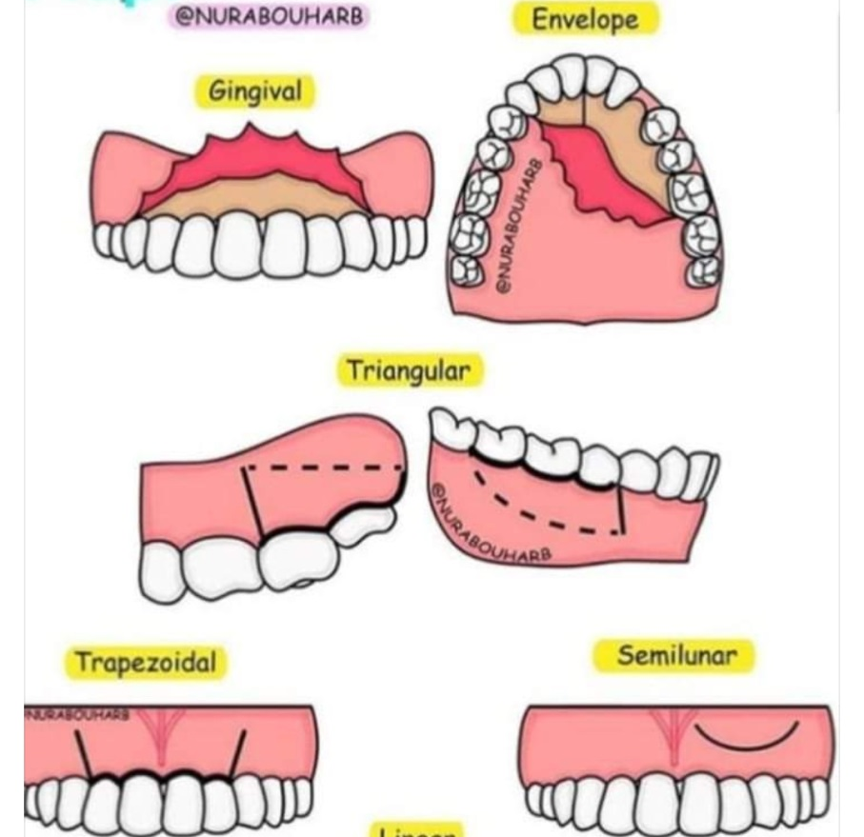
The several types of flap surgery are:
envelope flap: no vertical incision with the mucoperiosteal flap retracted from a horizontal incision line.
Triangular flap: single vertical (releasing) incision
Trapezoid flap: two releasing incisions
Semilumnar flap: horizontal incision
Trapezoidal flap:
mucoperiosteal: mucosal tissue flap, including the periosteum, reflected from the bone; also called full thickness flap.
partial thickness flap: surgical flap, including mucosa and connective tissue but no periosteum.

Slide 35
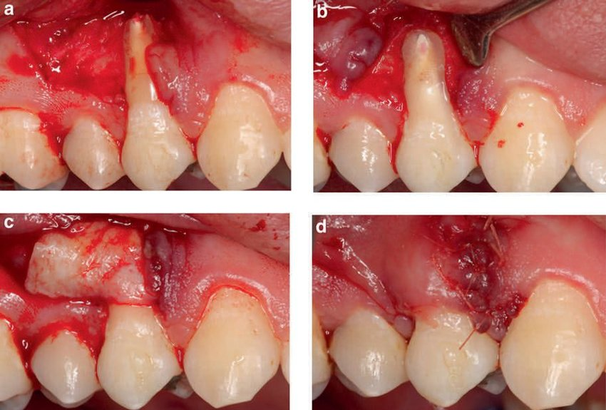
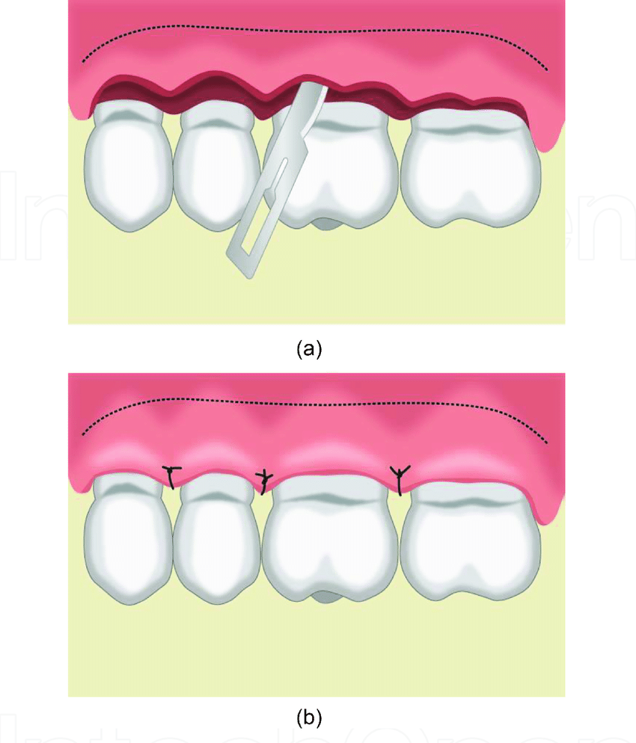
pedicle flap: tissue flap with lateral incisions.
sliding flap: pedicle flap resituated to a new position.
positioned flap: flap that is moved to a new position apically, laterally, or coronally.
repositioned flap: surgical flap replaced into its original position.

Slide 36
osseous surgery: tissue surgery with alteration in bony support of the teeth.
re-entry: second-stage surgical procedure to enhance or improve conditions from a previous surgical procedure.
vestibuloplasty): surgical alteration of the gingival mucous membrane in the vestibule of the mouth, including frenum reposition or frenectomy and change in muscle attachment.
ENAP (excisional new attachment procedure): removal of chronically Inflamed soft tissue to permit formation of new tissue attachment.
guided tissue regeneration: placement of a semipermeable membrane (Gore-Tex) beneath the flap to prevent ingrowth of epithelium between the flap and the defect; encourages the growth of new periodontal attachment.

Slide 37
Periodontal dressing packs are placed over the surgical site to assist with protection and healing. These packs are mixed, prepared, and expressed on the surgical site. They are supplied in four ways:
Zinc oxide and eugenol powder and liquid that are mixed to a paste, rolled, and pressed over the site.
Zinc oxide paste and a non-eugenol base paste that are mixed together and applied to the area.
Syringe-dispensed periodontal paste that is expressed on the site and light cured
Gelatin packs that dissolve and do not need to be removed.

Slide 38
Bone Grafting:
Some periodontal surgical techniques require bone tissues. Bone grafts involve transplants to restore bone from periodontal disease.
Related terms are:
allograft : human bone graft from someone other than the patient.
autograft : bone graft from another site in the same patient.
xenograft : graft taken from another species, such as cow or pig bone (experimental).
allogenic : addition of synthetic material to repair or build up bone.

Slide 39
Periodontal Involvement with Dental Implants and Cosmetic Dentistry:
In addition to treatment of the gingiva and periodontium of the mouth, the periodontist performs a variety of tissue and bone augmentations or reductions needed for a functional or cosmetic improvement. Some of these procedures used to provide optimal dental care are listed in the following subsections.

Slide 40
Dental Implants:
Dental implants are titanium or ceramic devices that are surgically placed into the alveolar bone to provide firm, fixed anchors for dental appliances or . The bone and the implant complete a process of uniting called osseointegration (union of bone and device).
Terminology relevant to periodontics is defined here:
endosteal: implants of various designs placed within the bone.
subperiosteal: implant placement beneath the periosteum and onto the bone.
transosteal: implant placement through the bone.
endodontic: the implant is set within the apex of the root.
Periodontal cleaning and scaling procedures performed on implants must be completed with plastic, sonic instruments, or the newer titanium scalers to protect the implants from surface scratching.

Slide 41
Cosmetic Dentistry:
Some treatments performed in a periodontist’s practice are used for cosmetic purposes to complete the treatment plan or to improve the esthetic appearance of the patient. Some of these procedures are:
crown lengthening: removal of excessive gingival covering tooth enamel in the sulcus area. May be done to gain access to areas of decay for restoration work or to remove a “gummy smile” appearance for esthetic reasons .
soft tissue graft: periodontal flap coverage of exposed root areas or repair of pocket damage.
pocket reduction: eliminate collection area from pocket position; may include bone grafts.
ridge augmentation: bone graft inserts to reshape to the natural contour of gingival and alveolar bone.
sinus augmentation: raising the floor of the sinus cavity and building bone replacement may be necessary for placement of maxillary implants in cosmetic surgery.
combination procedures: union of more than one procedure to achieve cosmetic effect.

Slide 42
Instrumentation for Periodontics:
Periodontal treatment requires specialized instruments, most of which are hand instruments, although ultrasonic, sonic, laser, and power-driven tools are also part of the necessary setup.
Periodontal Hand Instruments:
Hand instruments employed in periodontal treatment, illustrated in are used in a push or pull method to accomplish a desired outcome. Push instruments use a push stroke direction with a blade-to-tooth angle of less than 45 degrees perpendicular to the instrument’s shaft. An example is the chisel. Pull instruments use a pull stroke direction with a blade-to-tooth angle of between 45 and 90 degrees perpendicular to the instrument’s shaft. The most effective pull angle is approximately 75 degrees. Examples include scalers, curettes, hoes, and files.

Slide 43
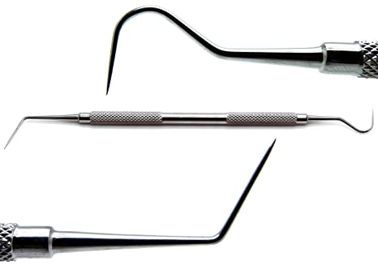
Hand instruments are:
periodontal probe: used to measure the depth of the periodontal pocket by determining the amount of gingival tissue attachment. A probe may be flat or round bladed and is marked in measured increments. Automatic periodontal probes are available and are used by inserting the probe wire into the sulcus area to determine and record the measurement on a computer.
explorer: instrument with a longer, tapered, thin wire tip to determine calculus formation, restoration overhangs, and any root furcation involvement.

Slide 44
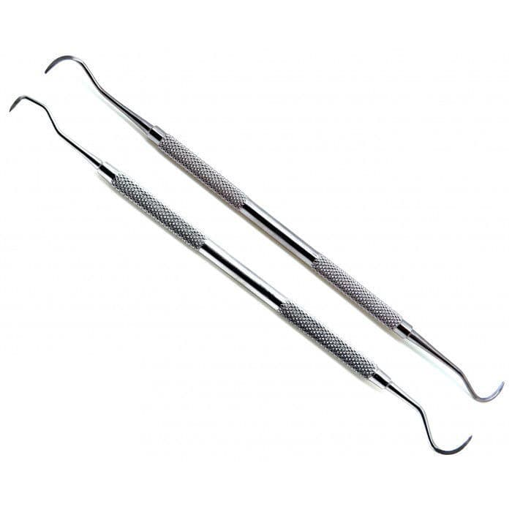
scaler: instrument with a sharpened blade to remove supragingival calculus deposits and stains. Scalers are available in various shapes such as sickle for universal use, straight for anterior areas, and contra-angled for posterior areas.

Slide 45
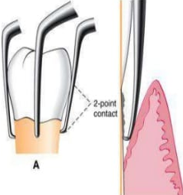
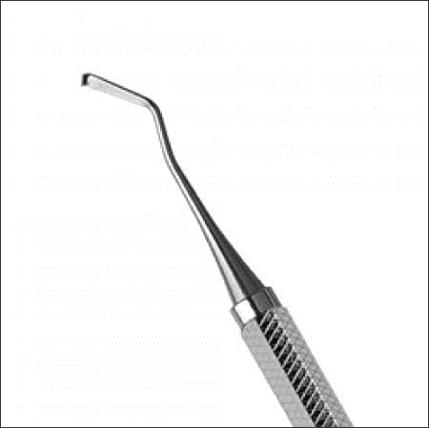
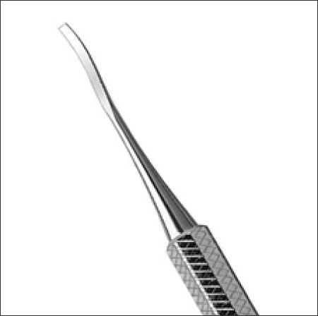
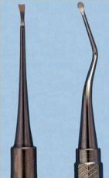
hoe: instrument with a long shank and a hoe-like tip; used to remove heavy or thick supragingival calculus in posterior areas.
chisel: instrument with a longer shaft and a chisel-bladed tip; used to break off and remove heavy calculus in the anterior region.
file: hand instrument with multiple cutting edges; used to smooth off rough and uneven tissues and remove stubborn calculus deposits.

Slide 46
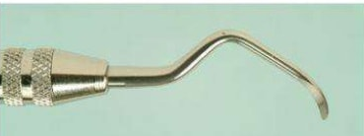
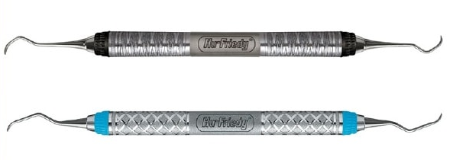
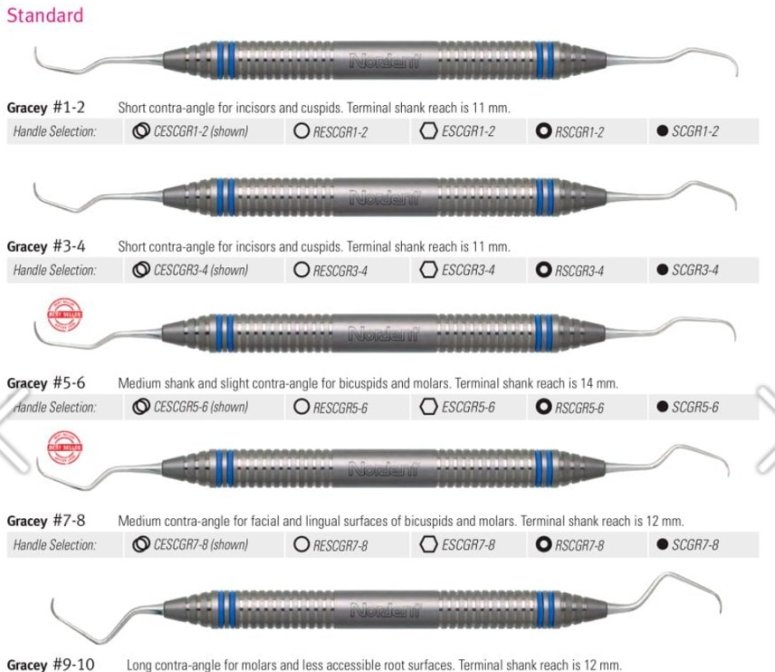
curette: instrument with longer shaft and working end with a rounded toe and back edge to access and remove subgingival deposits.
A universal curette has a cutting edge on each side of the blade to enable use in all areas.
Other curettes are designed for specific areas, such as the Gracey curettes with a cutting edge on one side of the blade.

Slide 47
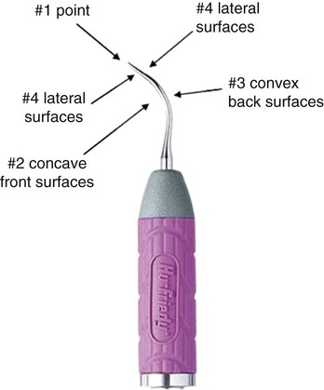
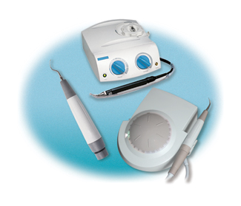
ultrasonic and sonic instrument tip: inserted into the ultrasonic handle; sonic forces move the tip in rapid, short (0.001 inch) waves at speed frequencies of 20,000 to 35,000 vibrations per second to break apart and dislodge deposits from the tooth surface. The tips or inserts are designed for specific areas and designated use. Machine tips are cooled with a water spray to lessen friction heat. Some handpieces have light sources for better viewing.

Slide 48
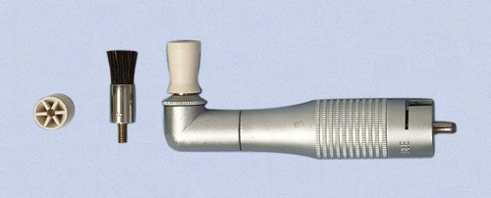
Polishing Instruments:
Instruments used to polish the tooth surfaces include straight handpieces, prophylaxis contra-angles, and rubber cups as well as polishing agents, such as pumice, cleaners, and chemically impregnated rubber points. Polishing and stain removal is completed by using an air-power-driven calcium carbonate powder spray unit or a slow handpiece rotary rubber cup with pumice.

Slide 49
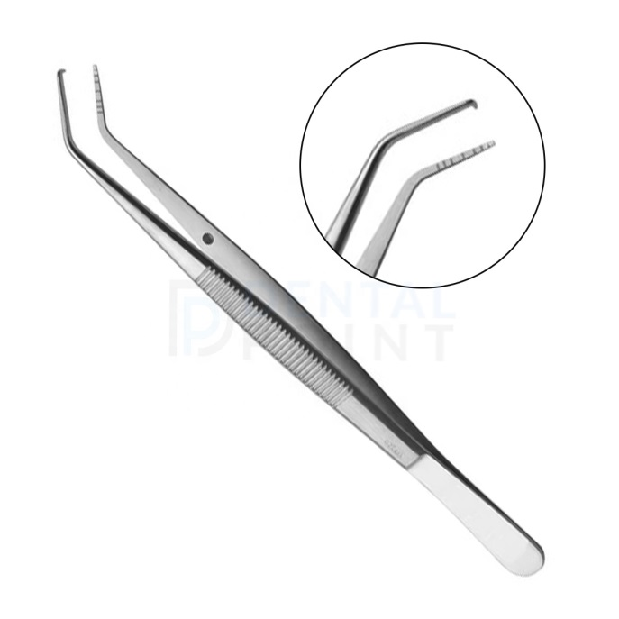
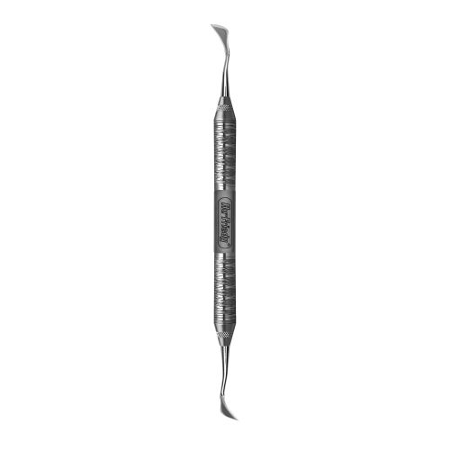
Surgical Periodontal Instruments:
The following are instruments used in surgery:
periodontal pocket marker: set of instruments similar to tweezers with a sharp point on one tip for insertion into the depth of the pocket and then compressed to make puncture marks indicating pocket depth. There is one marker for each side of the pocket.
periodontal knives: used to make incisions for removal of tissue or to obtain flap design. Blade shape may be round or pointed and long edged.

Slide 50
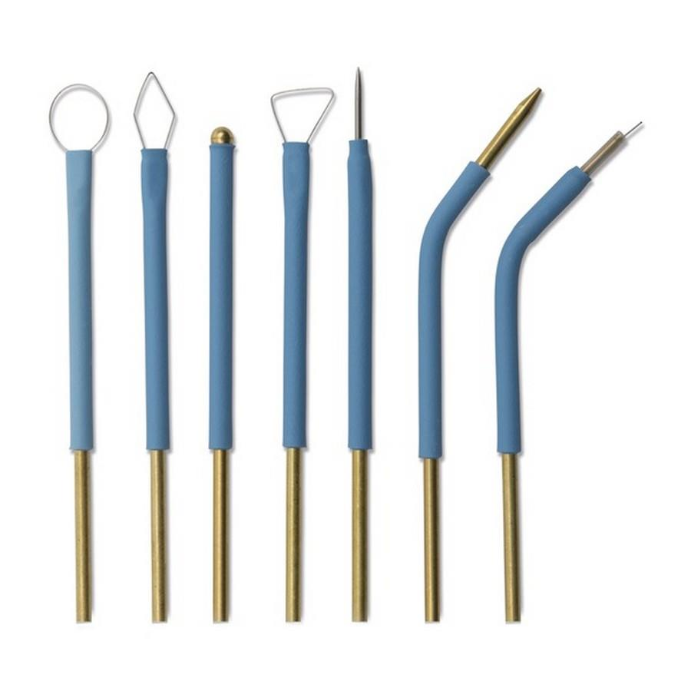
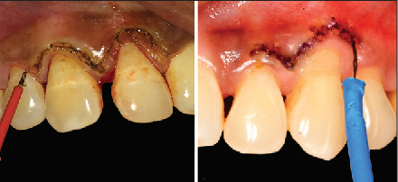
electrosurgery tips/unit: apparatus using electrical current to incise tissue and coagulate blood at the same time; useful in periodontal flap, tissue grafting, crown lengthening, and other tissue surgeries.

Slide 51
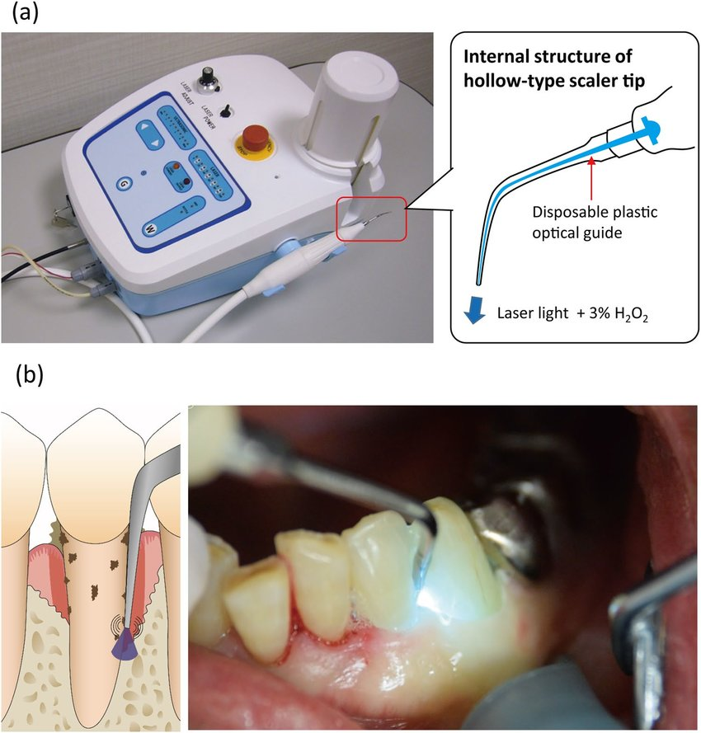
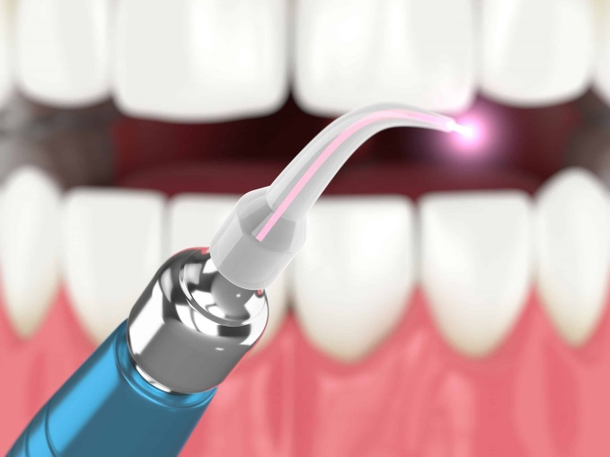
laser tip/unit: apparatus delivering energy in light form at different wavelengths; can be used in soft or hard tissue curettage surgery when regulated to the specific bacterial target.

Slide 52


